Slide 1
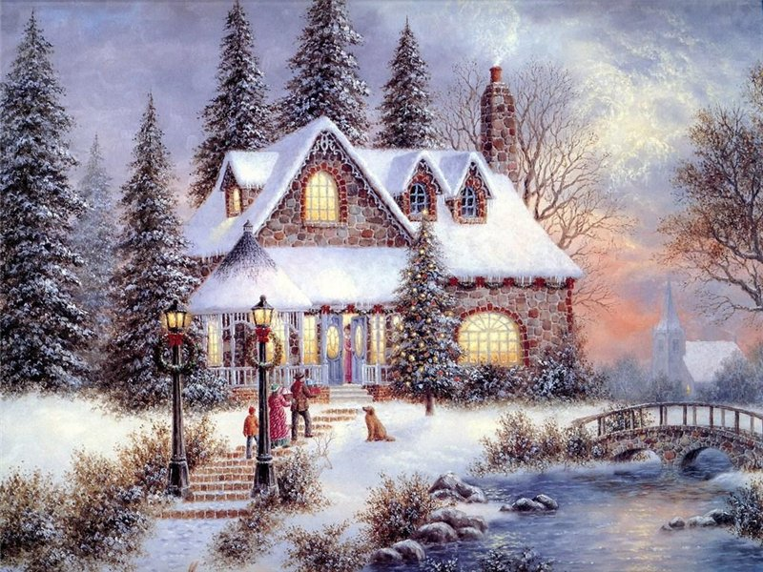
Merry Christmas!
Данилочкина Е.С.
МОУ гимназия №36 г. Иваново
Учитель английского языка

Slide 2

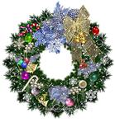
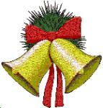

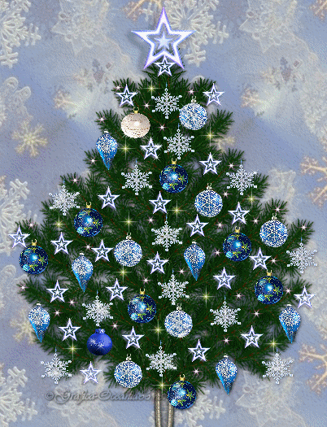

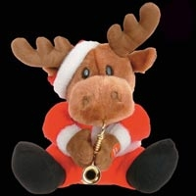
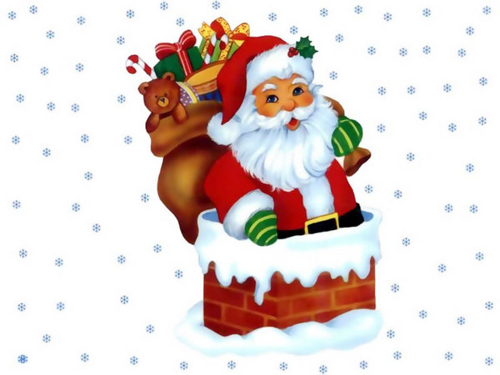
Christmas symbols
bell
wreath
candle
fireplace
reindeer
gift
stocking
Father Christmas

Slide 3
Christmas traditions
Sing carols
Decorate a Christmas tree
Give each other presents
Send Christmas cards
Eat a Christmas pudding and roast turkey

Slide 4
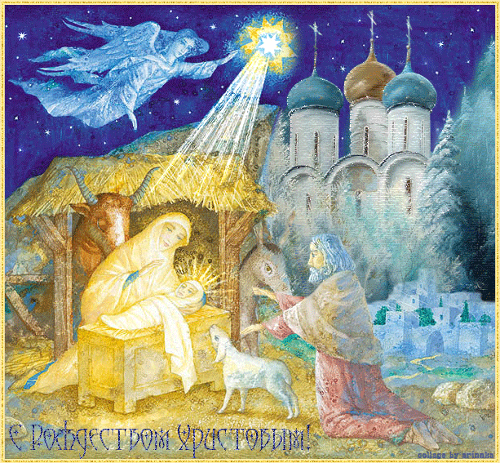
Christmas is a religious holiday .It’s celebrated on the 25-th of December.
On this day British people celebrate the birth of Jesus Christ .
This holiday means the beginning of the new year and the new life.

Slide 5
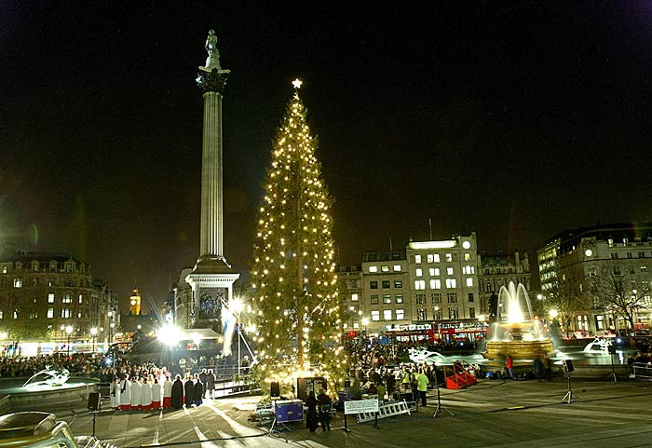
Every Christmas British people are presented a big Christmas tree by Norway. They put it up in Trafalgar Square in London.
Streets and houses are decorated with lights.

Slide 6
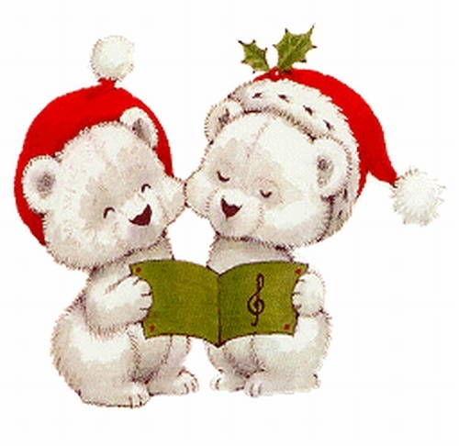
Christmas Day is the greatest holiday in England. It is interesting to visit the shops before this holiday. There are a lot of nice Christmas cards and presents there.
One of Christmas traditions is singing carols

Slide 7
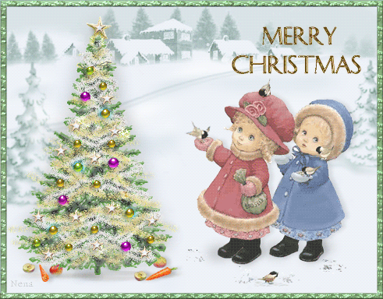
Sending Christmas cards is another tradition .People send Christmas cards to their relatives and friends and wish them a Merry Christmas
Christmas is a family holiday and people try to celebrate it with their families.

Slide 8
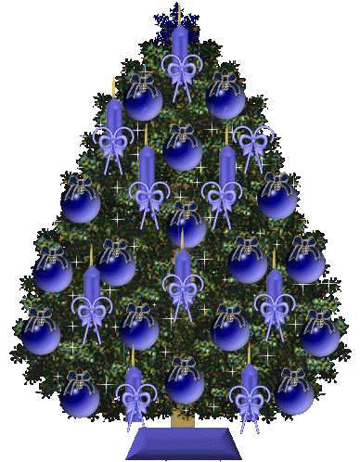
People put up a Christmas tree near the fireplace and decorate it with toys, lights and sweets. British families always go to churches on Christmas
Schoolchildren have two-week Christmas holidays
Children write letters to Father Christmas and ask him for presents.

Slide 9
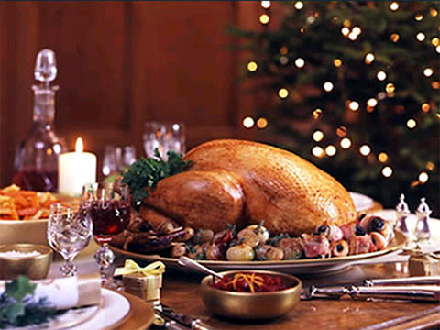
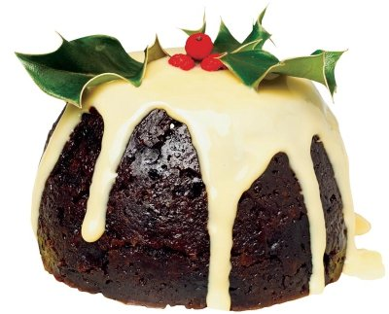
English families gather to have Christmas dinner. They eat traditional Christmas food :a roast turkey and a pudding.

Slide 10
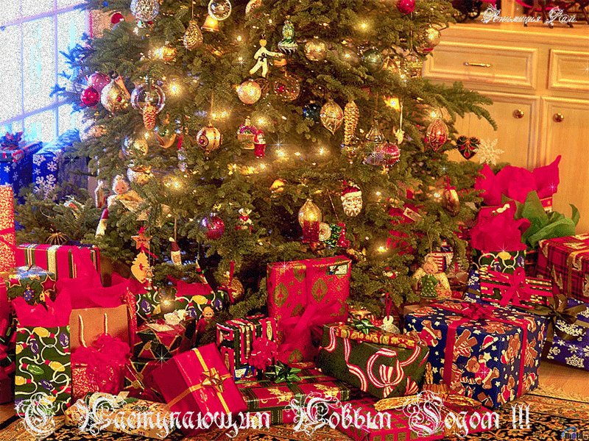
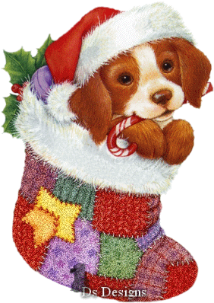
Father Christmas comes at night and puts presents in the colorful stockings and under the Christmas tree
In the morning children find their presents there.

Slide 11
Write down a letter to Father Christmas and tell him how Christmas is celebrated in Russia
winter holidays
Christmas tree
presents
food
decoration
cards
Use the words as a plan

Slide 12
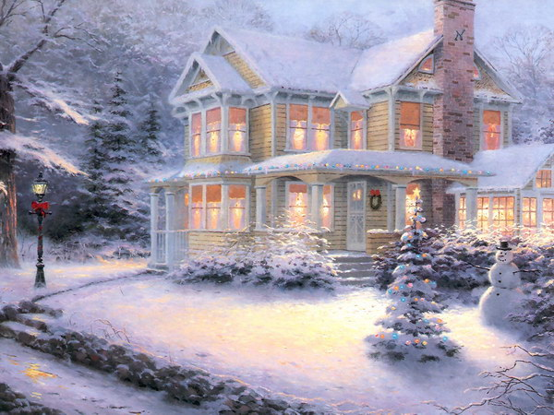


Slide 13

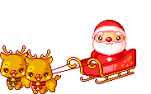
Bye, Father Christmas! See you next year!

Slide 14
Ресурсы
http://best-vikas.mylivepage.ru/image/2025/20824_%D0%91%D0%BE%D0%BB%D1%8C%D1%88%D0%B0%D1%8F_%D0%B0%D0%BD%D0%B8%D0%BC%D0%B0%D1%86%D0%B8%D1%8F_-_
%D0%A1_%D0%A0%D0%BE%D0%B6%D0%B4%D0%B5%D1%81%D1%82%D0%B2%D0%BE%D0%BC%21%21%21gif
http://fotki.yandex.ru/users/sunny-fanny/view/122249/
http://900igr.net/fotografii/istorija/1-Prazdniki.files/Prazdniki-Rossii.html
http://kirillova.nsknet.ru/christmas
http://www.statusline.ru/index.php?action=art&nart=492&page=agencyелка
http://forum.autoua.net/showflat.php?Number=2905305&page=1
http://rado76.wordpress.com/category/%d0%bb%d0%b8%d1%87%d0%bd%d0%b8/
http://blog.pravil-net.ru/?p=70
http://blogs.privet.ru/community/www001com/tags/465122
http://innulenka68.ya.ru/replies.xml?item_no=13
http://www.babyplan.ru/forums/viewtopic.php?f=28&t=8542&st=0&sk=t&sd=a&start=915
http://blogs.mail.ru/mail/ladiez63/7c204bc2bb3b21b5.html
http://blogs.privet.ru/community/nychannel
http://blogs.mail.ru/mail/vznakprotesta/44DB6B8E4B6507AF.html
http://www.krestianin.ru/articles/168/?SECT%3Ca_%3Ca_href=&SECTION_ID=168%25%3Ca+href%3D&PAGEN_1=16 сhttp://www.asdcompany.ru/cataloque/viewware/?id=352&gid=168
http://forum.korabel.net/viewtopic.php?p=107605&sid=558adda2a6666e1984b6bf8193978823
http://www.ntv.ru/novosti/182931/
http://www.travel-info.ru:8080/browse_blogs.php?p=79
http://www.bridge.in.ua/ru/add/articles/christmas-in-britain
http://www.stk-travel.ru/calendar/
http://karot.at.ua/news/2008-12-25-309
http://jar-magic.ru/forum/index.php?topic=1180.160

