Slide 1
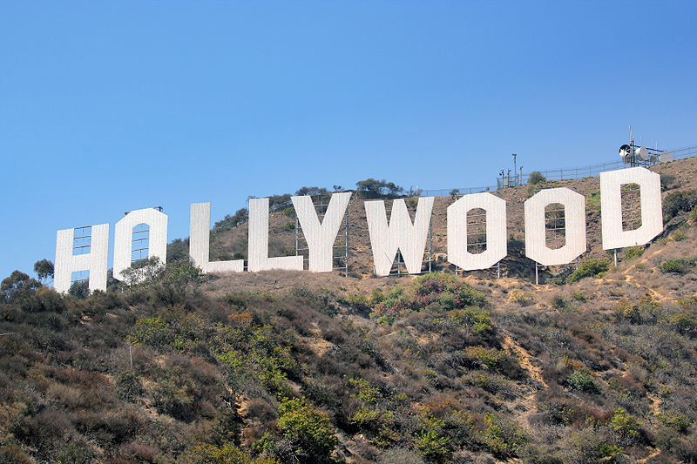

Slide 3
The Nestor Company built the first motion picture studio in Hollywood in 1911. It is here that the first film studios originated: Universal Studios, Twentieth Century Fox, and Paramount.

Slide 5
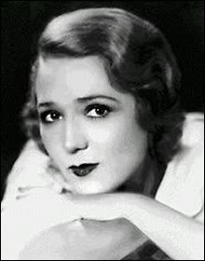
Mary Pickford

Slide 6
Charlie Chaplin

Slide 7
The greatest cartoon-maker in cinema history was Walt Disney (1901-1966).

Slide 8
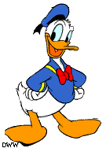
He produced his first black and white Mickey Mouse cartoon in 1928. Then Disney created the second cartoon superstar – Donald Duck.

Slide 10
The hollywood bowl

Slide 11
The popular Walk of Fame consists of 1,800 bronze stars set in the sidewalks along Hollywood Boulevard and Vine Street.

Slide 12
The “Hollywood” sign

Slide 13
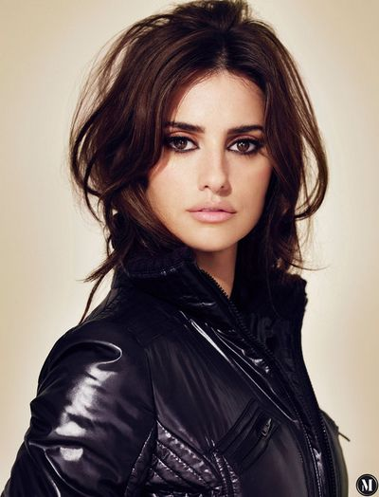
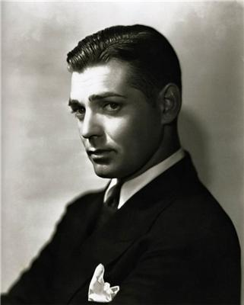
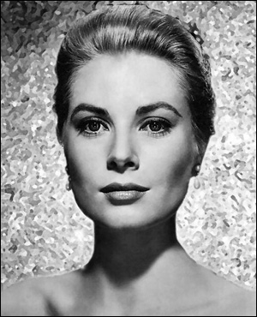
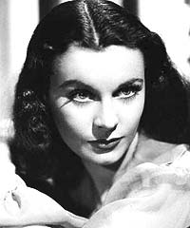
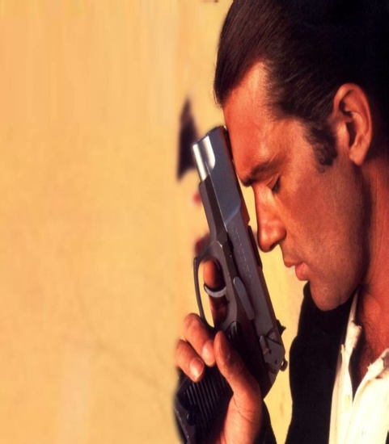
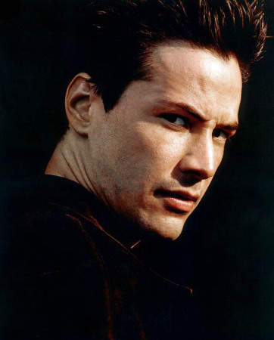

Slide 14
Chinese Theatre

Slide 15
Hollywood High School

Slide 16
Kodak theatre

Slide 17
Thank you for attention

