Slide 1
FAMOUS BRITISH WRITERS
Here are the names of some famous
British writers whose portraits are
exhibited in the National Portrait Gallery.
Листратова Ольга Владимировна
учитель английского языка
МКОУ МВ(С)ОШ при ФКУ ИК – 3 УФСИН России по Амурской области

Slide 2
Цель урока :
Воспитание личности учащегося на основе общечеловеческих ценностей, развитие у школьников инициативности и самостоятельности, толерантности и уважения к другим нациям и культурам к успешной самореализации, обучение познавательной деятельности с использованием иностранного языка.

Slide 3
Задачи :
Развивать учащихся внутренние мотивации к изучению языка и культуры, развитие у детей внимания и восприятия, слуховой памяти, мышления и воображения, способности к аналитической деятельности.
Расширение кругозора учащихся, за счет ознакомления с новой информацией по теме: British Writers

Slide 4
Here are some more names of well-known British writers :
William Shakespeare
Daniel Defoe
Walter Scott
Robert Burns
Lewis Carroll
Charles Dickens
Oscar Wilde

Slide 5
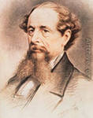
Charles Dickens
(1812-1870 )
-an English novelist.
His many famous books describe life in Vicktorian England and show how hard it was, especially for the poor and for children.
They include : Oliver Tvist, David Copperfield .

Slide 6
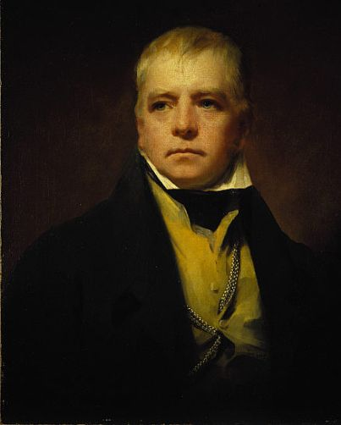
Walter Scott
( 1771-1832 )
- a Scottish writer and a poet, especially famous for his stories of Scottish life, several of them are based on historical characters, such as Ivanhoe and The Heart of Midlothian

Slide 7
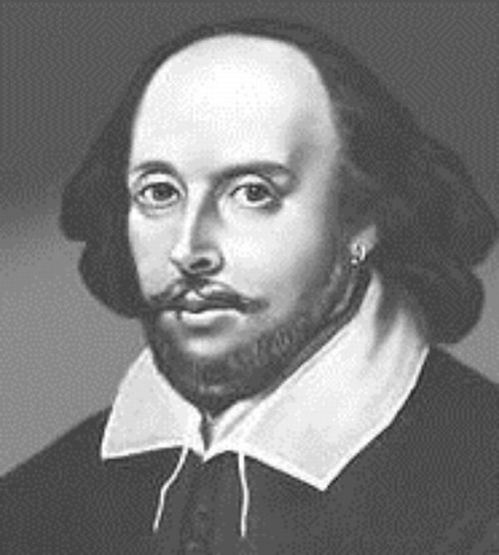
William Shakespeare
(1564-1616)
-an English writer of plays ,one of the most famous ever. Among the most famous of his plays are the tragedies of Romeo and Juliet, Julius Caesar, Hamlet, Othello, King Lear, the comedies of A Midsummer Night’s Dream, The Merchant of Venice, and the historical plays Richard ııı and Henry V. He also wrote some very good poetry, especially the Sonnets, and worked as an actor at the Globe Theatre in London.

Slide 8
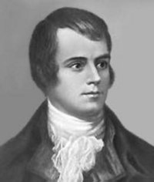
Robert Burns
(1759-1796)
-a Scottish poet who wrote hundred of songs and poems, mainly on country life,love,and national pride

Slide 9
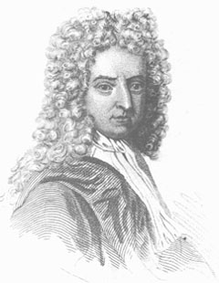
Daniel Defoe
(1660-1731 )
- An English writer, whose most famous novels are Robinson Crusoe and Moll Flanders

Slide 10
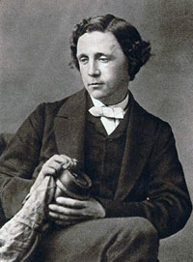
Lewis Carroll
(1832-1898)
-an English writer who wrote two well-known children’s stories, Alice's Adventures in Wonderland. His real name was Charles Lutwidge Dodgson

Slide 11
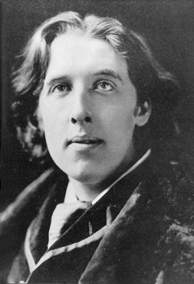
Oscar Wilde
(1854-1900)
-an Irish writer best known for his play The Importance of Being Earnest and his story The Picture of Dorian Gray. Many of the clever and funny things he said in conversations are still famous

Slide 12
Match the names of the writers and the countries they came from
Scotland
Ireland
England
William Shakespeare
Lewis Carroll
Charles Dickens
Robert Burns
Walter Scott
Oscar Wilde
Daniel Defoe

Slide 13
Match the names of the writers and the books they are famous for :
Lewis Carroll
David Copperfield
Robert Burns
Romeo and Juliet
Walter Scott
Robinson Crusoe
Daniel Defoe
The Picture of Dorian Gray.
William Shakespeare
The Heart of Midlothian
Charles Dickens
Alice's Adventures in Wonderland
songs and poems
Oscar Wilde

Slide 14
Which one would you recommend your foreign friend to read to learn more about Russian literature ?
I would recommend the book
Alice's Adventures in Wonderland.
It
was written by
William Shakespeare.
It is
a tragedy.
It is about
love.
The main characters in the book are
Romeo and Juliet.
I particularly love reading it because
it is perfect way to entertain
Oneself.

Slide 15
Thank you for your work

Slide 16
Интернет ресурсы
http://ref.repetiruem.ru/referat/viljam-shekspir1 William Shakespeare
http://ru.picscdn.com. Lewis Carrol
http:// www.allposters.com.tr Charles Dickens
http://rustrek.ru/viewtopic.php?t=22494 Oscar Wilde
http://elite-home.narod.ru Daniel Defoe
http://www.russianmiami.com Walter Scott
http://www.citycat.ru Robert Burns

