Slide 1
                CHICAGO

Slide 2

As every road had once led to Rome, every road in America leads to Chicago.

Slide 3
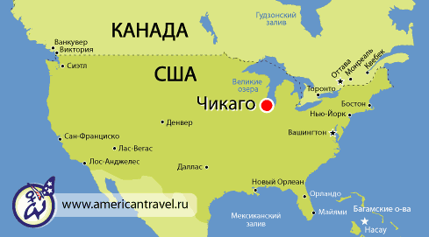
Chicago map shows that Chicago is located in the Midwestern United States on the southwestern shores of Lake Michigan, bordering the Illinois-Indiana State Line.

Slide 4
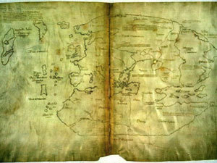
  For many centuries before Chicago was visited by a white man ,it was the home of the red-skins Indian tribes.

Slide 5
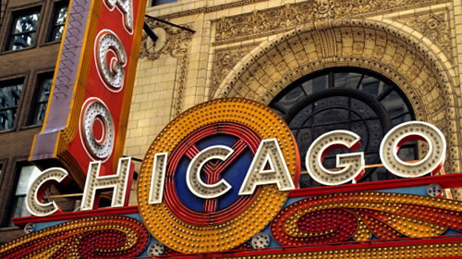
Chicago has three million people and is the third-biggest city in the United States. It grew up quickly, being incorporated as a city only in 1837.

Slide 6
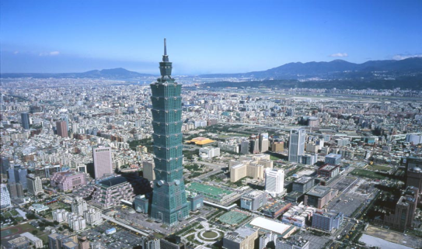
The city of Chicago was founded in 1833 and it rapidly became a major transportation and telecommunication hub in North America. It is considered as a center of international business and commerce and is listed as the world's top ten global financial centers.

Slide 7
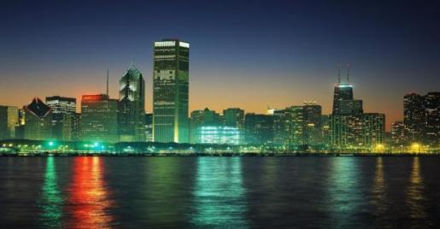
Chicago’s nicknames are: the Windy City, the City of Big Shoulders, the Second City, and The City That Works.

Slide 8
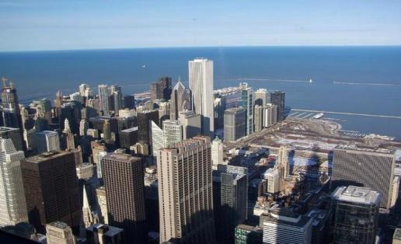
Today, Chicago is known as the Windy City. Walking around it you might suspect that Chicago got this nickname from the winds off Lake Michigan. But the true origin of the saying comes from politics.

Slide 9
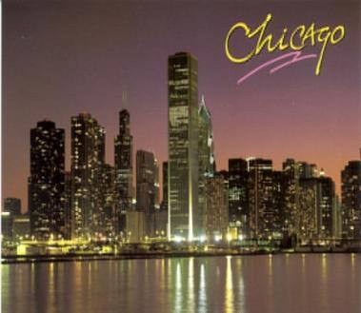

Chicago used its central position to become the primary railroad linking the eastern and western United States.

Slide 10
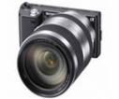
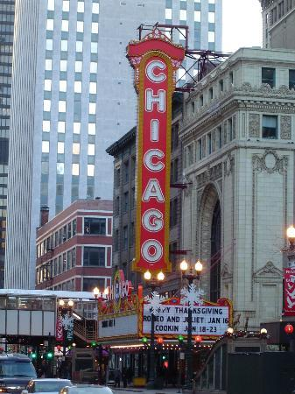
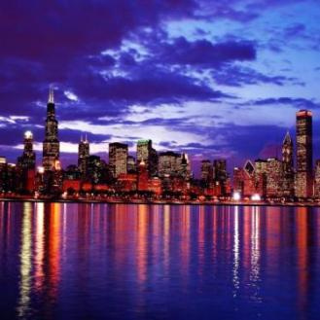
Chicago is famous for its architecture, culture, entertainment and business

Slide 11
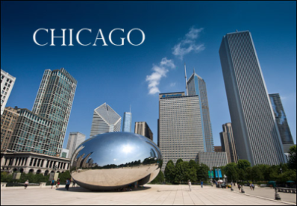
The city is visited by millions of tourists every year.
Millennium Park...
Cloud Gate
See yourself and a reflection of the city skyline in artist Anish Kapoor’s interactive sculpture that sits in the center of the Park.
Chicago looks great from every angle

Slide 12

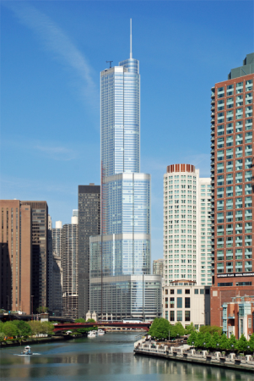
It’s no wonder
that President Barack and Michelle Obama – and nearly three million others – call Chicago
home.
The Willis Tower is the tallest building in the Western Hemisphere at 110 stories high.

Slide 13
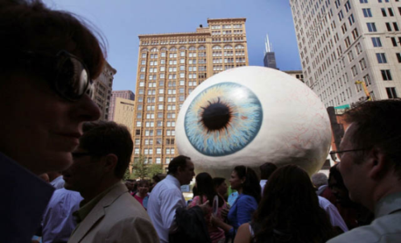
                Chicago's "Eye" sculpture

Slide 14
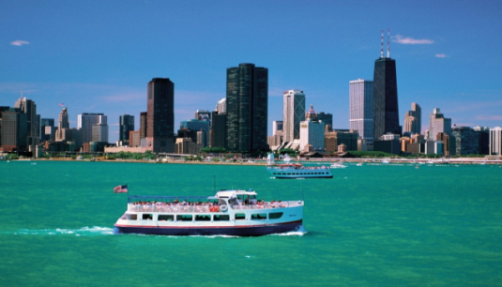
There is so much to do in the city that many visitors want to come back time and time again to see the sights you’ve never seen before and revisit the ones you enjoyed the most.

Slide 15





SHOPPING
Shop till you drop! From luxury and trendy fashion boutiques to Department stores.

Slide 16
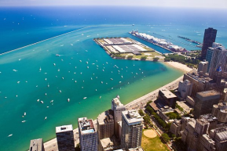

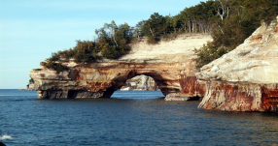
Chicago is on Lake Michigan, which has 26 miles of beaches, trails, and boardwalks. In the "Windy City" temperatures range from minus 30 degrees Fahrenheit in winter to more than 100 in summer.

Slide 17
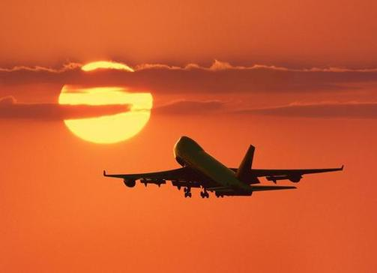

THE END

