Slide 1
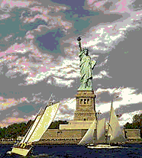
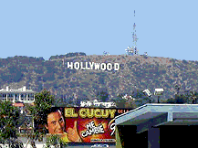
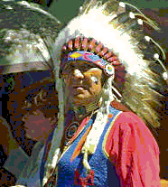
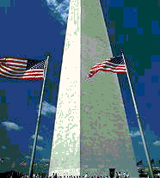
The USA

Slide 2
Match
The American flag
is often
called the ….
It has … stripes
and … stars,
one for each … .
50
State
“Stars and Stripes”
13

Slide 3
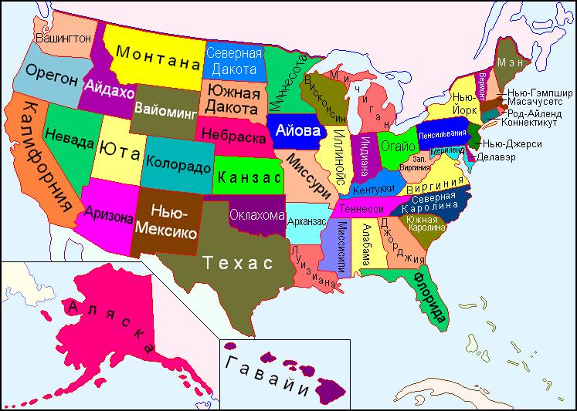
The USA
There are 50 states.
Alaska and Hawaii are not
connected to the other states

Slide 4
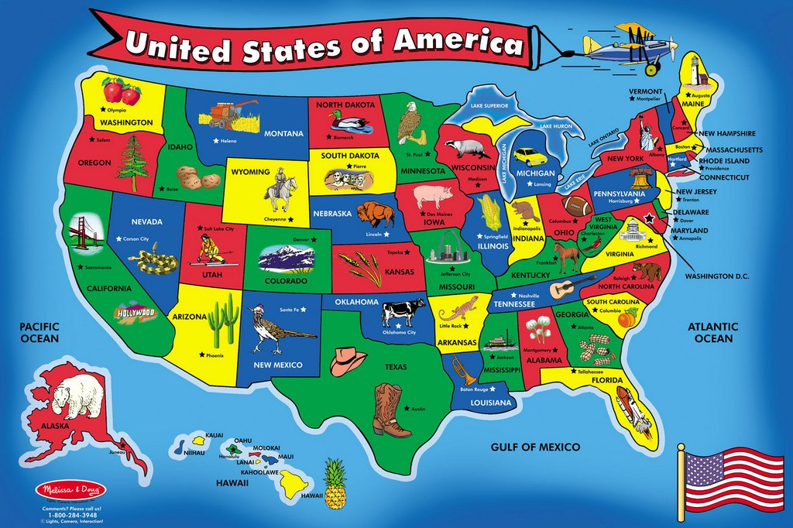
The USA is washed by the
Pacific, the Atlantic Ocean,
by the Caribbean Sea and
The Gulf of Mexico

Slide 5
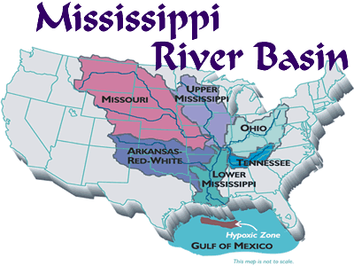
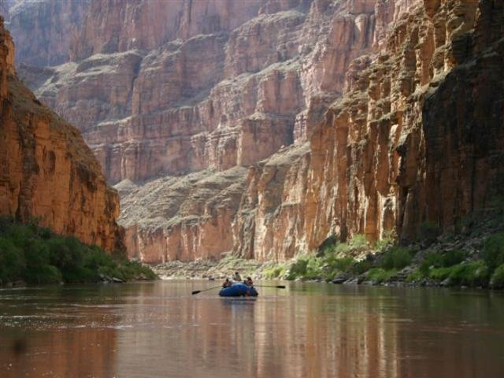
Rivers
Mississipi begins
in the north and
ends in the gulf
of Mexico (6400km)
The Colorado river
rises in the
Rocky Mountains

Slide 6
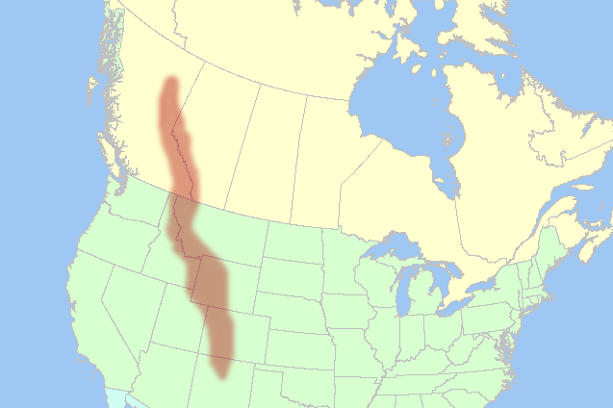
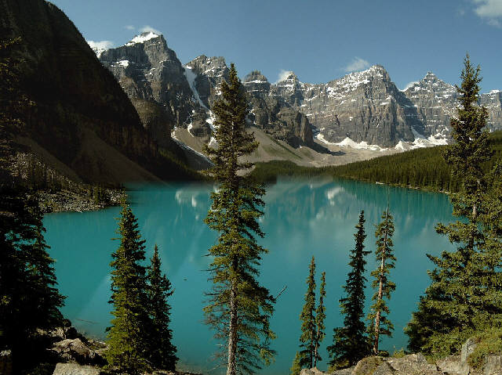
Mountains
The Rocky Mountains
stretch from Alaska down
almost to the south
of the country

Slide 7
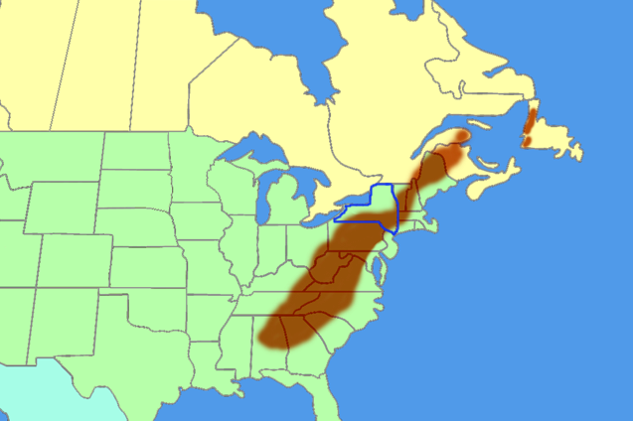
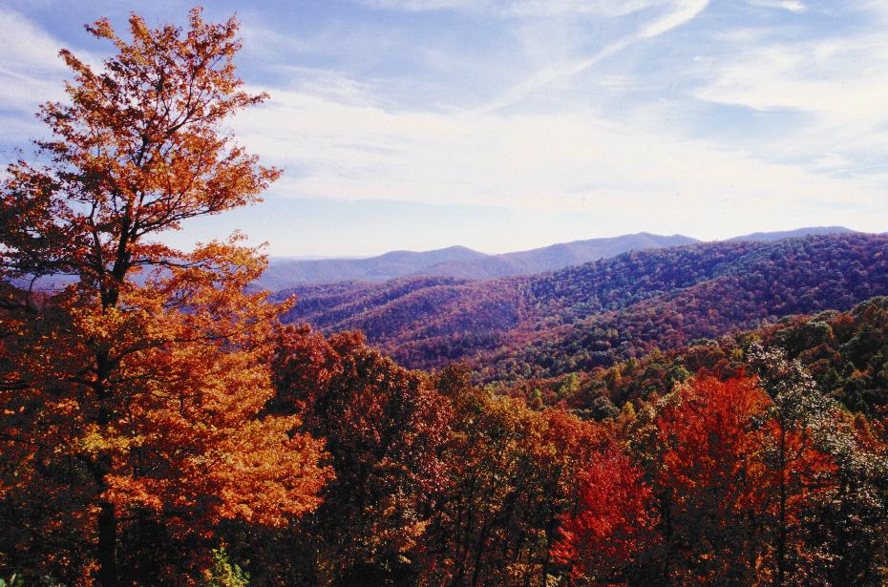
The Appalachians are in
the east and run
from north to south

Slide 8
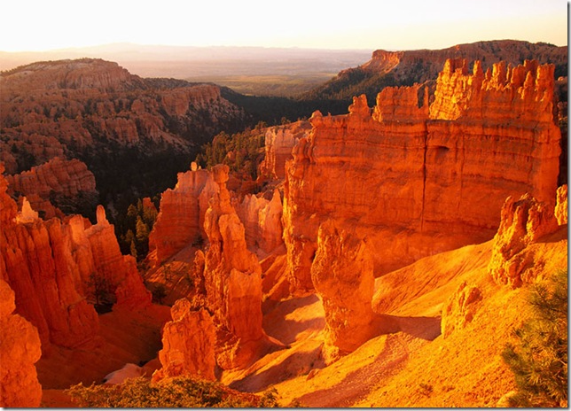
The Grand Canyon
The Colorado River formed
the Grand Canyon over
millions of years

Slide 9
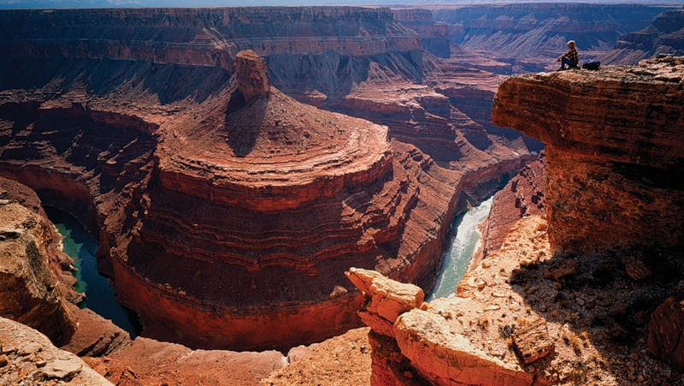
The canyon is one mile deep
and 200 miles (320 km) long

Slide 10
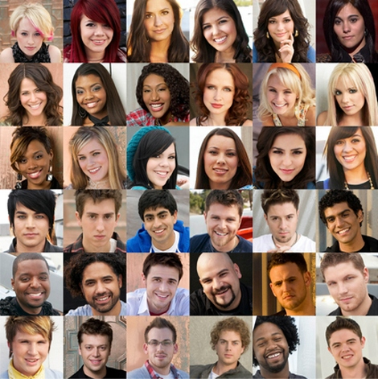
Americans
The people of
America are
a mixture of
many different
nationalities –
a melting pot

Slide 11
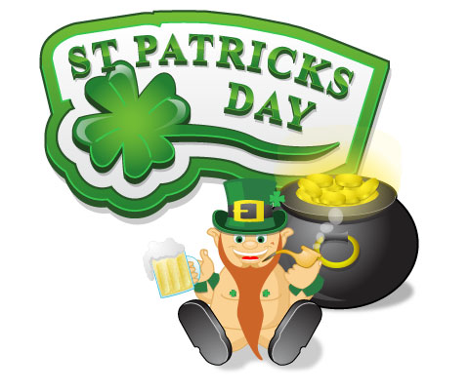
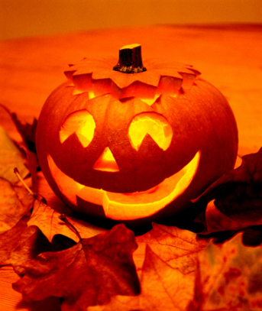
The people And traditions
The Germans brought
Christmas trees.
The Irish brought St.
Patrick’s Day celebrations
The Scots brought
Halloween.

Slide 12
Match
The Scots brought
Halloween.
The Irish brought St.
Patrick’s Day celebrations
The Germans brought
Christmas trees.

Slide 13
Answer the questions
1 What are the longest
rivers of the USA?
2 WHY ARE AMERICAN PEOPLE
CALLED a MELTING POT?
3 What traditions did people
bring to America?

