Slide 1
Местоимения some any no
Френдак Галина Емельяновна,
учитель английского языка
Копьёвской средней школы

Slide 2
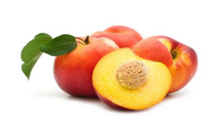
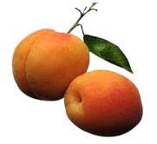
Some - утвердительные предложения
Any – вопросительные предложения
No = not any - отрицательные предложения
I have some peaches.
Do you have any apricots?
I have no friends.
I have not any friends.
I don’t have any friends.

Slide 3
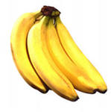
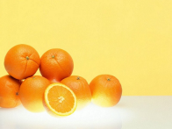
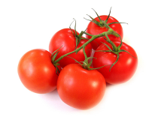
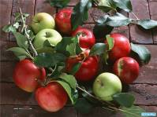
some
несколько
с исчисляемыми существительными
Some bananas
Some oranges
Some tomatoes
Some apples

Slide 4
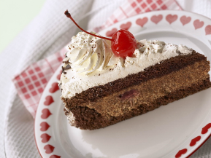
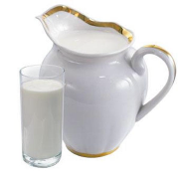
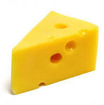
немного
Some
с неисчисляемыми
Some sausage
Some cake
Some milk
Some cheese

Slide 5
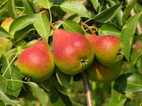
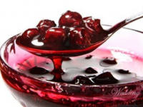
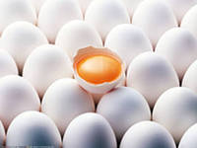
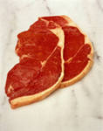
несколько
немного
There are some pears on a tree.
There is some jam in a jug.
There are some eggs on a table.
There is some meat on a plate.

Slide 6
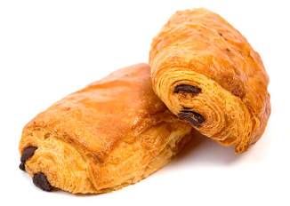
Вопросительные предложения
с исчисляемыми
any
Are there any lemons on a table?
Yes, there are some.
Are there any buns at home?
Yes, there are some.

Slide 7
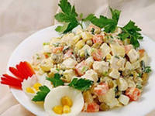
С неисчисляемыми
Is there any soup in the plate?
Yes, there is some.
Is there any salad in a plate?
Yes, there is some.

Slide 8
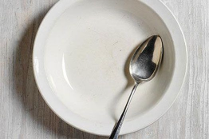
Отрицательные предложения
Not any = no
There isn’t any soup in the plate.
I have not any soup.
There is no soup in the plate.
I have no soup.
There are not any apples in the basket.
I have not any apples in my basket.
There are no apples in the basket.
I have no apples in my basket.

Slide 9
Вставить some или any
They have….. milk.
My brother doesn’t read ……. books.
Do you have ……. questions?
We need ……. eggs and ……. milk.
I don’t have ……. water.
I have …… tea in my cup.
We don’t have ……. bread.
Kate doesn’t have ……. sweets.
Pete and Ann have ……. bars of chocolate.
Mary hasn’t …… mistakes in her test.

Slide 10
ключ
ключ
They have some milk.
My brother doesn’t read any books.
Do you have any questions?
We need some eggs and some milk.
I don’t have any water.
I have some tea in my cup.
We don’t have any bread.
Kate doesn’t have any sweets.
Pete and Ann have some bars of chocolate.
Mary hasn’t any mistakes in her test.

Slide 11
Вставить is или are
There ……. some butter in the basket.
There ……. no apples in the shop.
There ……. ten pears on the table.
There ……. two oranges in my bag.
There ……. some porridge in the plate.
There ……. some books on the desk.
There ……. some bread in a bin.
There ……. no water in the jug.
There …… no sweets in the vase.
There …… some fish in the fridge.

Slide 12
Ключ
There is some butter in the basket.
There are no apples in the shop.
There are ten pears on the table.
There are two oranges in my bag.
There is some porridge in the plate.
There are some books on the desk.
There is some bread in a bin.
There is no water in the jug.
There are no sweets in the vase.
There is some fish in the fridge.

Slide 13
Вставить no или not any
There is ……. honey in my tea.
There aren’t ……. apples in the fridge.
There isn’t ……. soup in the plate.
There are ……. sweets in my pocket.
There aren’t ……. cakes in the shop.
There is ……. bad students in our class.
There are ……. any TVs in my room.
There is ………. any pepper in the soup.
There are ……… lemonade in the bottle.
There are ……….any bars of chocolate in the cupboard.

Slide 14
Ключ
There is no honey in my tea.
There aren’t any apples in the fridge.
There isn’t any soup in the plate.
There are no sweets in my pocket.
There aren’t any cakes in the shop.
There are no bad students in our class.
There aren’t any TVs in my room.
There is not any pepper in the soup.
There is no lemonade in the bottle.
There are not any bars of chocolate in the cupboard.

Slide 15
Перевести на английский
У меня есть несколько яблок.
У меня нет воды.
У тебя есть какие – нибудь книги?
В холодильнике нет молока.
На столе несколько стаканов.
В кармане нет конфет.
У моего брата есть несколько друзей.
У Анны нет компьютера.
В сумке нет тетрадей.
На столе есть несколько книг.

Slide 16
ключ
I have some apples.
I have no (not any) water.
Do you have any books?
There is no (not any) milk in the fridge.
There are some glasses on the table.
There aren’t any (are no) sweets in my pocket.
My brother has some friends.
Ann doesn’t have any computer.
There are no (not any) copybooks in the bag.
There are some books on the table.

Slide 17
Использованные ресурсы
http://img-fotki.yandex.ru/get/4706/119528728.8e9/0_90aa1_b046f8e8_XL бананы
http://img.desktopwallpapers.ru/food/pics/oranges.jpg апельсины
http://m001.bcm.ru/2024/8628b527-a930-49f6-8518-4369ec312a9f.jpg помидоры
http://portalik.flyfm.net/uploads/posts/2011-07/1310987776_1310926459_62883382_1282157400_022d66f536d6.jpg яблоки
http://i044.radikal.ru/1101/9b/595c15a4b7ae.jpg колбаса
http://parikmaherov.net/upload/blogs/8ea9a22e2305a1aad31064acd61fba4a.jpg.jpg сыр
http://natali.biz/wp-content/uploads/2011/03/3a30d2f5a1b5.jpg молоко
http://www.zastavki.com/pictures/640x480/2012/Food_Cakes_and_Sweet_Cake_with_cherries_031487_29.jpg торт
http://static.freepik.com/free-photo/pears_2577421.jpg груши
http://im4-tub-ru.yandex.net/i?id=211197341-57-72&n=21 варенье
http://cs5970.vkontakte.ru/u5731752/98571329/x_2d4b3706.jpg яйца
http://im6-tub-ru.yandex.net/i?id=6876691-38-72&n=21 мясо
http://im7-tub-ru.yandex.net/i?id=65943879-00-72&n=21 лимоны
http://vkusnosti.org/uploads/taginator/May-2012/bulochka-s-foto.jpg булочки
http://www.bioneer.ee/static/files/085/supp..jpg суп
http://im8-tub-ru.yandex.net/i?id=139843220-40-72&n=21 салат
http://www.robertopiecollection.com/Application/images/wicker-baskets/garden-vegetable-basket-lg.jpg корзина
http://samara.in.ua/wp-content/uploads/2012/12/236689_.jpg тарелка
http://www.tvoyrebenok.ru/images/presentation/happy-birthday/m/019.jpg титульный слайд

Slide 18
http://i.klubkrasoti.ru/content/image/248.jpg персики
http://www.dagpravda.ru/images/materials/full_Vkusnoipolezno.jpg абрикосы
http://img1.liveinternet.ru/images/foto/b/1/apps/1/244/1244997_0_41036_1e8a7769_l.jpg ребенок
http://s41.radikal.ru/i091/1007/27/0c86a3d7ee0e.gif собака
http://pedsovet.su/_ld/328/24669138.jpg шаблон для ключей
http://www.ikt.oblcit.ru/67/Mischtschenko_TS/index.files/slide0045_background.gif фон

