Slide 1
Презентация
«Хорошие манеры»
урок английского языка
6 класс
Автор:
Уткова
Татьяна Станиславовна
учитель английского языка
МОУ-СОШ № 8
города Аткарска Саратовской области

Slide 2
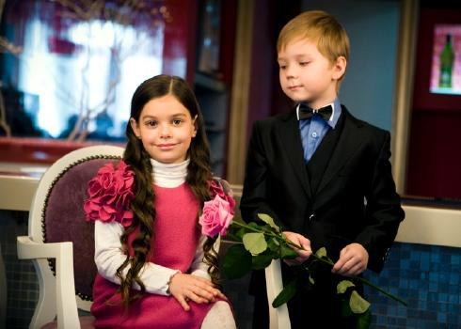
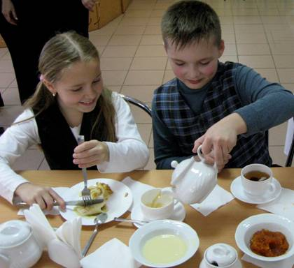

Slide 3
GOOD MANNERS

Slide 4
Focus on phonetics
[i:] – be, sweet, street, please
[æ] – thanks, at, and , have
[əu] – polite, home
[e] - friends, remember
[ɔ:] - always

Slide 5
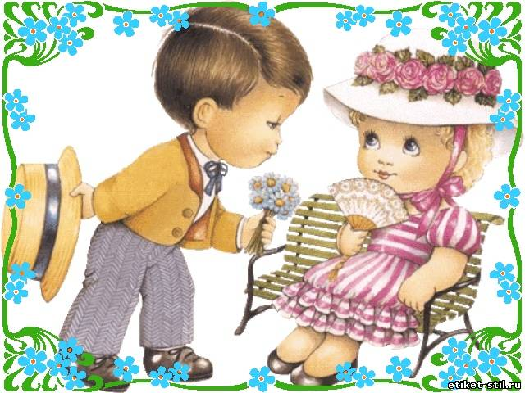
Always be polite and sweet
At your home, in the street.
Remember please, goodbye and thanks,
And you will have a lot of friends.

Slide 6
Open your books,
page 97, exercise 57.

Slide 7
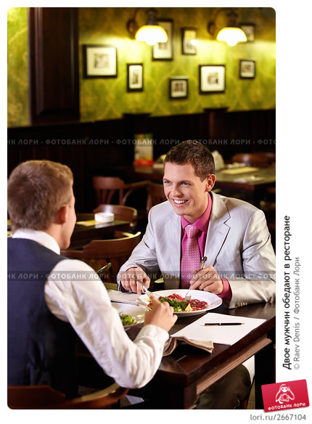

Slide 8
Let’s relax
Hands up! Hands down!
Hands up! Hands down! Hands up! Clap! Clap! Hands down! Hop! Hop!
Hands on hips!
Bend left! Bend right!
Bend left! Bend right!
Clap! Clap! Stand still!
Sit down, pleas.

Slide 9
Find in the table next phrases.
Спасибо большое Excuse me
Извините меня Thank you very much
Пожалуйста Sorry
Угощайся. Thanks, it’s great.
Как мило с вашей стороны Please
Простите Help yourself
Спасибо, это вкусно How kind of you

Slide 10
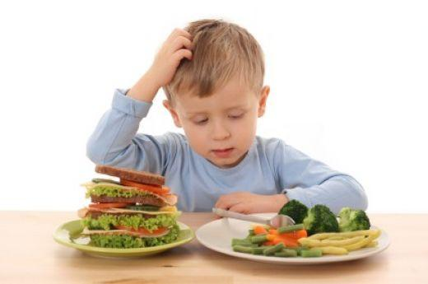
The dialog for the first group:
Mother: Mike, breakfast is ready.
Mike: Well, Mother, I am here.
Mother: What do you want to eat?
Mike: I want a cup of tea and some cheese.
Mother: Do you want some milk?
Mike: Yes, please.
Mother: All right! Sit down and eat.
Mike: Thank you, Mother.

Slide 11
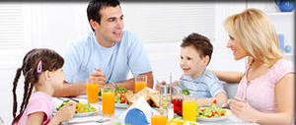
The dialog for the second group:
Mother: Dinner is ready.
Father: Good appetite.
Daughter: Would you like a cup of tea?
Son: Just a little, please.
Father: The soup is very delicious.
Son: I like it very much.
Daughter: Will you pass me the salt?
Mother: OK.

Slide 12
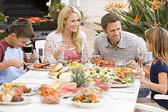
The dialog for the third group:
Jane: Thanks, Mother, it was lovely!
Father: Yes, the dinner was really delicious today! I really enjoyed it!
Mother: Would you like some salad, Jim?
Jim: Oh, thanks, mom. I’m already full. But it was rely very nice.
Mother: What did you like most?
Jim: The salad. It was great. Thank you.
Mother: You are welcome!

Slide 13
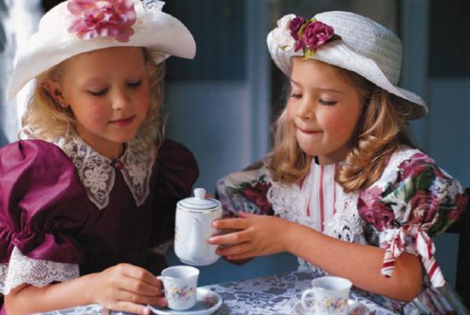
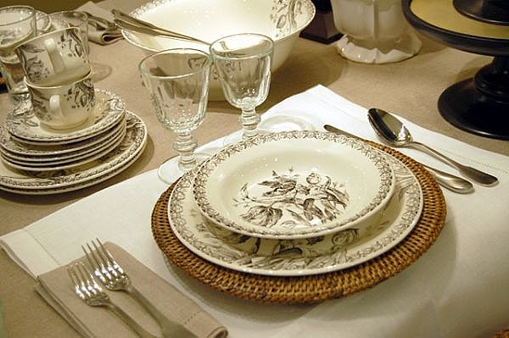
TABLE MANNERS
1. | We ………… speak with our mouth full.
2. | We ………… put the table napkin on our knees.
3. | We ………… reach (тянуться) across for the salt.
4. | We ………… use the fork and knife properly.
5. | We ………… put our elbows on the table.
6. | We ………… wave (махать) the knife or fork in the air.
7. | We ………… eat noiselessly (бесшумно).
8. | We ………… wash our hands before we eat.

Slide 14
You should write down what we must and mustn’t do at the table.
1. We ………… speak with our mouth full.
2. We ………… put the table napkin on our knees.
3. We ………… reach (тянуться) across for the salt.
4. We ………… use the fork and knife properly.
5. We ………… put our elbows on the table.
6. We ………… wave (махать) the knife
or fork in the air.
7. We ………… eat noiselessly (бесшумно).
8. We ………… wash our hands before we eat.
1. | We ………… speak with our mouth full.
2. | We ………… put the table napkin on our knees.
3. | We ………… reach (тянуться) across for the salt.
4. | We ………… use the fork and knife properly.
5. | We ………… put our elbows on the table.
6. | We ………… wave (махать) the knife or fork in the air.
7. | We ………… eat noiselessly (бесшумно).
8. | We ………… wash our hands before we eat.

Slide 15
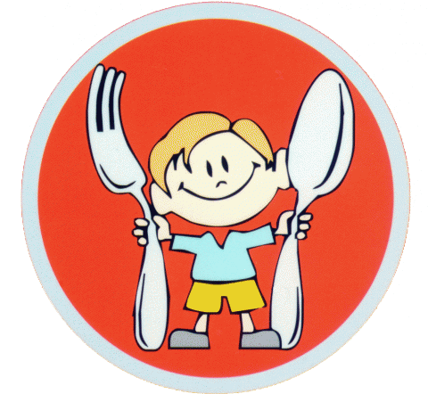
Check yourself!
We mustn’t speak with our mouth full.
2. We must put the table napkin on our knees.
3. We mustn’t reach (тянуться) across for the salt.
4. We must use the fork and knife properly.
5. We mustn’t put our elbows on the table.
6. We mustn’t wave (махать) the knife or fork in the air.
7. We must eat noiselessly (бесшумно).
8.We must wash our hands before we eat.

Slide 16
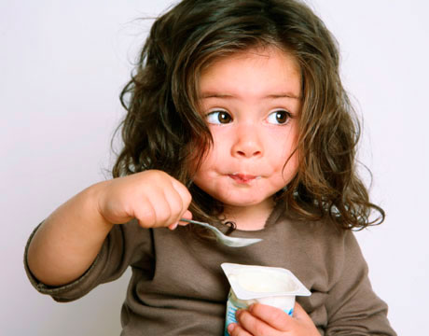
Appetite comes with eating.
Аппетит приходит во время еды.

Slide 17
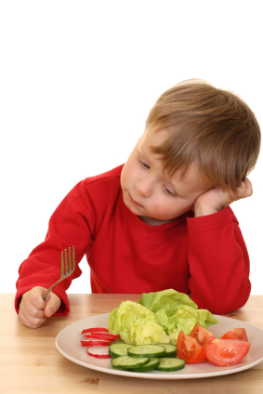
Dear boys and girls, Remember gold rules: When you sit at the table Don’t lick your fingers Sit up straight and say thank you, Use your knives and forks or spoons, But don’t put your elbows on the table.

Slide 18
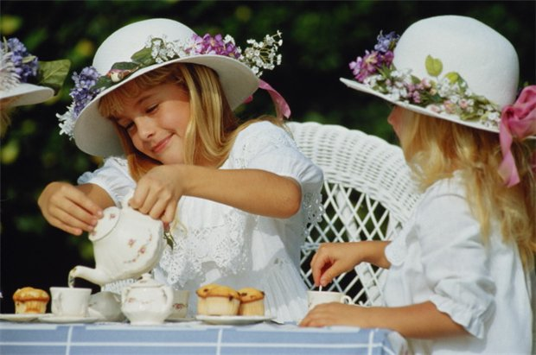
Thank you for your work!

Slide 19
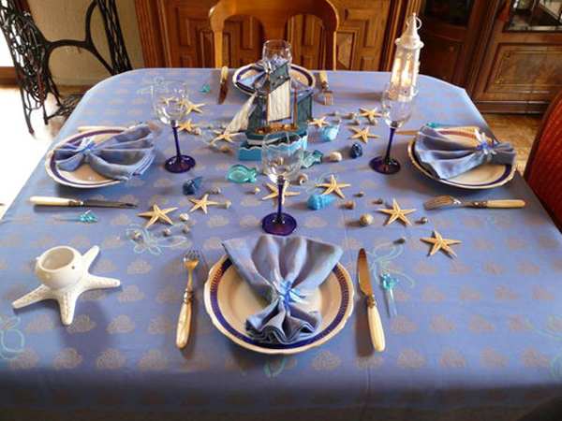
HOME WORK
Learn poem by heart
“Good manners”.

